Slide 1
Lecture 20 October 18, 2019
Lab tomorrow---using class data as a sample of a population. Also working with cv y f females for our cross.
Looking ahead. I will be out of town, Nov. 25th.
I am moving Exam 3 from Nov. 18th to Nov. 22. (That means no Genetics lecture or lab all of Thanksgiving week).

Slide 2
Where were we?....
Lethal alleles
2-gene traits
Epistasis in 2-gene traits

Slide 3
What ratio of phenotypes would you expect from a cross of 2 wild-type heterozygotes?
Red pigment (R gene)
Brown pigment (B gene)
Assume a recessive genotype results in no pigment.
RrBb X RrBb 16 box punnett square ?

Slide 4
Dihybrid ratio!
9 R__B__ brick red (wild type)
3 R__bb bright red
3 rr B__ brown
1 rrbb white
9:3:3:1

Slide 5
1 trait controlled by 2 genes– what might give it away?...
More than 2 variations
A dihybrid ratio or (modified dihybrid ratio---see next example) in a cross involving one trait, indicates 2 genes control the trait.

Slide 6
Another 2-gene trait Labrador retriever color…
Pure breeding black and pure breeding yellow mate
Black labs (from different black and yellow parents)
Theoretical ratio:
9 black: 3 brown(chocolate) :4 yellow
(ratio is in 16ths)

Slide 8
Explanation?...
Looks very similar to dihybrid ratio---modified dihybrid ratio.
9:3:4 =9:3:(3 +1)
Coat color controlled by 2 genes. (A and B)
a recessive genotype for one of the genes masks the expression of the other gene.

Slide 9
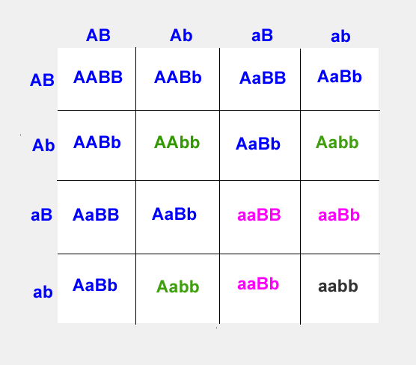
AaBb X AaBb
A_B_ =black
A_bb = brown
aaB_ =yellow
aabb= yellow

Slide 10
Molecular mechanism?
B gene controls production of pigment. Black is dominant to brown.
B_ = black pigment
bb = brown
A second gene, A, controls expression of any pigment.
A_ (allows proper expression of the B/b alleles)
aa (masks expression of B/b alleles---fur appears yellow/white)

Slide 11
9:3:4 (3+1) is an indication that a trait is controlled by 2 genes and shows recessive epistasis.
Mouse coat color works similarly---see p.83
3 coat colors Agouti, black and white (albino)

Slide 12
Dominant epistasis…
Similar phenomenon, but in this case a dominant allele masks/modifies expression of a second gene.
Summer squash color.
Controlled by 2 genes, A and B
Gene B controls color-- yellow is dominant to green.
Dominant A allele give white fruit regardless of alleles of second gene B

Slide 13
Prediction?
Cross 2 heterozygous plants giving white squash
AaBb X AaBb
9 A__B__
3 A__bb
3 aa B__
1 aa bb

Slide 14
Prediction?
Cross 2 heterozygous plants giving white squash
AaBb X AaBb
9 A__B__
3 A__bb 12 white
3 aa B__ 3 yellow
1 aa bb 1 green

Slide 15
12:3:1 common indicator of dominant epistasis.
Molecular mechanism? Squash color is controlled by a gene (B) where yellow is dominant over green. A dominant allele of a second gene (A) overrides pigment production of any genotype at the (B) gene.

Slide 16
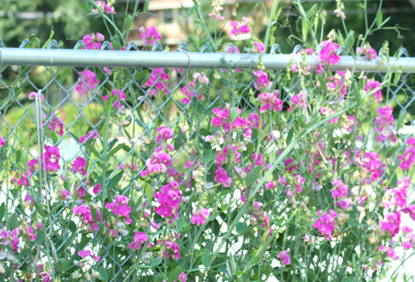
Another example of a 2-gene trait
Flower color in sweet pea (not garden pea)
Observed by William Bateson and Reginald Punnett—Yes he did experiments, not just squares!

Slide 17
Experiment..
Crossed 2 true-breeding strains of white-flowered sweet peas
F1 All purple! (What do you know about the genotype)
F2 9 purple:7 white

Slide 18
Explanation?
9:7 ratio
Ratio in 16th s suggests 2 genes
9 A__B__
3 A__bb
3 aa B__
1 aa bb
Bateson and Punnet proposed that purple flowers require both genes must have at least one dominant allele.

Slide 19
9 A__B__ purple
3 A__bb
3 aa B__ white
1 aa bb
Proposed mechanism of biochemical pathway…
gene A protein gene B protein
pigment precursor intermediate product final product
(colorless) (colorless) (purple pigment)

Slide 20
Sweet pea color genes give an example of 2 mutant alleles causing the same phenotype.
aaB_
A_bb white due to aa or bb genotype (Due
Aabb a lack of wild-type A or B allele)

Slide 21
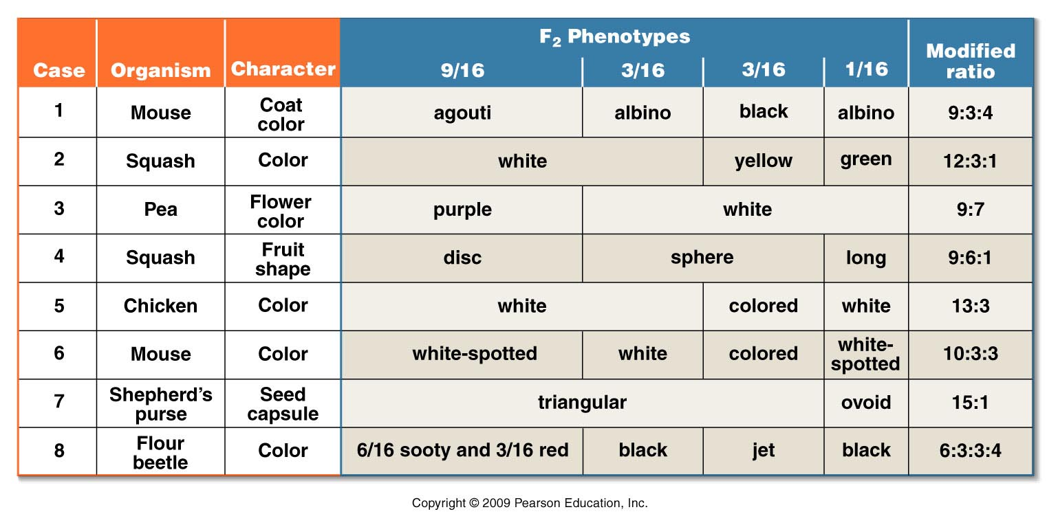
Examples of other modified dihybrid ratios (2 gene traits)
Try coming up with “molecular explanations” for some of these modified dyhibrid ratios! (Make a dihybrid Punnet square)
Figure 4.8
Notes:
Figure 4-8 The basis of modified dihybrid F² phenotypic ratios, resulting from crosses between doubly heterozygous F¹ individuals. The four groupings of the F² genotypes shown in Figure 4–7 and across the top of this figure are combined in various ways to produce these ratios.

Slide 22
How might you notice a trait controlled by 3 interacting genes?

Slide 23
Onward….
There is a class of traits controlled by multiple genes, but which differ in the mechanism by which they control a trait.
The traits are called quantitative traits.
Chapter 23 of your text deals with quantitative traits and has a lot of info on how to recognize/analyze traits with lots of variation.

Slide 24
….Quantitative traits (Chapter 23 , pages 604-609)
Thus far we have studied traits which show clearly contrasting forms or discontinuous traits
Tall pea plants vs. dwarf pea plants
Black, yellow, or chocolate labs
Blood type A,B,O, AB
All are the result of expression of specific allele combinations and specific mechanisms of gene expression

Slide 25
What about traits like…
Height?
Intelligence?
Skin color?

Slide 26
These traits show a wide variation of forms or continuous variation.
Most humans---~4 ft. 10 inches—6 ft. 8 inches
Skin color in offspring of the same parents with different skin color varies considerably. https://www.cnn.com/2017/01/24/health/biracial-twins-illinois-trnd/index.html
Red grain color (text example) varies from deep red to white.

Slide 27
Can we attribute these traits to specific genes?
Can we assume that Mendelian rules apply?

Slide 28
Yes and yes---but these are examples of quantitative traits.
Quantitative traits are controlled by several genes (and most of the time, also, environmental factors). Each gene involved contributes a specific increment of the same type to the phenotype. (so many inches, a degree of shade of color).

Slide 29
For each gene 2 types of alleles exist.
Additive (add a specific measurable increment to the phenotype)
Non-additive (add nothing to the phenotype)
Example---Genotype AAbbCcdd (3 additive alleles)

Slide 30
In our previous examples of 2-gene traits, the trait was the result of 2-genes, but those genes encoded 2 uniquely functioning proteins.
For example—ABO blood type:
I-gene encodes a protein that controls whether A or B antigen is produced.
Fut 1 gene encodes the h substance (protein for A or B antigen to be attached)
TOGETHER---the proteins create the blood type phenotype

Slide 31
“Redness” in grain
Let’s try an example---using 2 genes, but the 2 genes encode similarly functioning proteins.
In our example the proteins add a degree of red pigmentation to wheat.
We assume independent assortment of the 2 genes during meiosis.

Slide 32
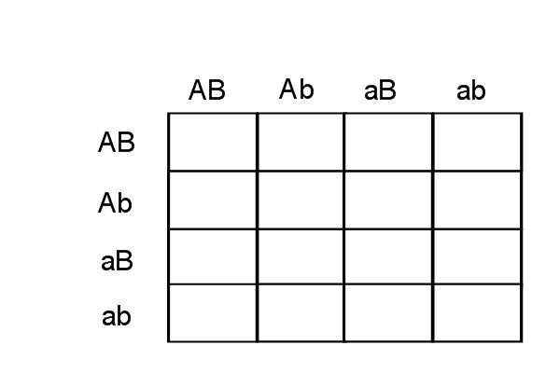
AaBb X AaBb—fill in the Punnett square and note the frequency of specific genotypes and how many additive alleles they would have

Slide 33
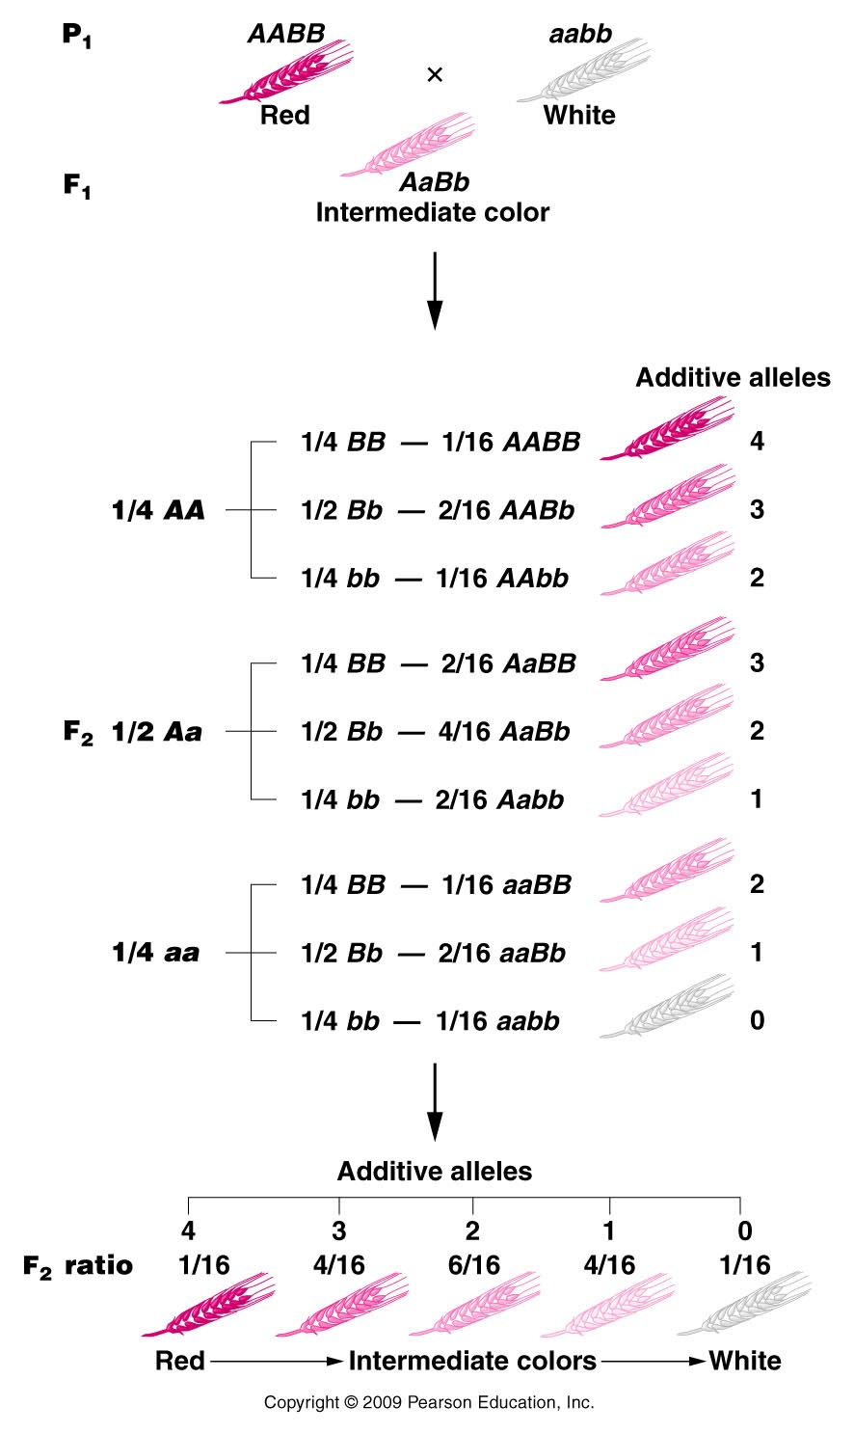
Consider a trait controlled by 2 genes---Quantitative trait.
How many different genotypes---count the additive alleles.
Max= 4 additive alleles
Min =0 additive alleles
3,2,1 additive alleles possible.
What does this intermediate form remind you of ?
Here we see several “intermediate” forms of red.
Figure 25.2
Notes:
Figure 25-2 How the multiple-factor hypothesis counts for the 1:4:6:4:1 phenotypic ratio of grain color when all alleles designated by an uppercase letter are additive and contribute an equal amount of pigment to the phenotype.

Slide 34
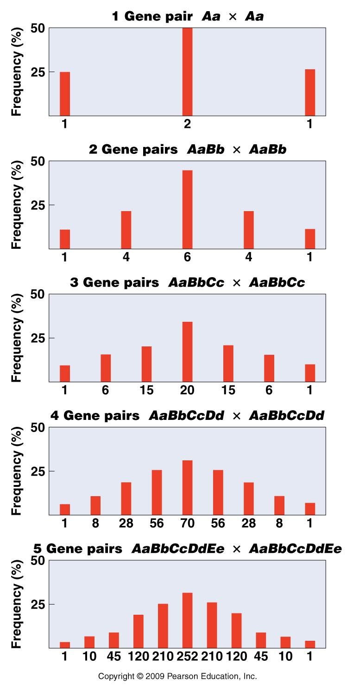
The number of intermediate forms in a quantitative trait increases with the number of genes involved!
Counting the number of intermediate forms, we see that we get 2n+1 versions of the trait, where n is the number of genes involved.
Figure 25.3
Notes:
Figure 25-3 The results of crossing two heterozygotes when polygenic inheritance is in operation with 1–5 gene pairs. Each histogram bar indicates a distinct F2 phenotypic class from one extreme (left end) to the other extreme (right end). Each phenotype results from a different number of additive alleles.

Slide 35
Clarification:
For quantitative traits we think of the extreme variations---such as deep red wheat and pure white wheat, and intermediate forms.
For a n=2 gene trait there are 2n-1=3 intermediate forms.
For a n=2-gene trait, there are 2n+1=5 total versions of the trait.

Slide 36
3 intermediate/5 total
5 intermediate/7 total
7 intermediate/9 total
9 intermediate/11 total

